Slide 1
92% of Americans suffer from a vitamin deficiency
*The Biostation

Slide 2
38% of American adults are low on energy at least 4 days of the week
*2,000 surveyed - The New York Post
Notes:
https://nypost.com/2024/01/05/lifestyle/feeling-burnt-out-survey-reveals-how-americans-increase-their-energy-levels/

Slide 3

A Vitamin Routine Based on Your Genes!
Notes:
Ansora is a for-profit company that uses microarray data to create personalized vitamins.

Slide 4
Vitamin | Corresponding gene | Gene function
Calcium | CASR | Calcium sensing receptor
Iron | HFE | Modulates iron metabolism
Folate | MTHFR | Creates an enzyme that processes amino acids
Vitamin D | DBP-1 and DBP-2 | Transports vitamin D, influences T cell responses
Vitamin A | BCMO1 | Metabolizes vitamin A
Vitamin K | VKORC1 | Helps form blood clots
Vitamin B12 | TCN2 | Transports vitamin B12 throughout body
Omega 3 and 6 | FA2H | Modifies fatty acids, protects nerves
Notes:
Ansora curates a personalized supplement routine based on genetic data that is analyzed using microarrays. These microarrays measure gene expression of many different target genes such as these. They can tell us what nutrients that we are deficient in.

Slide 5
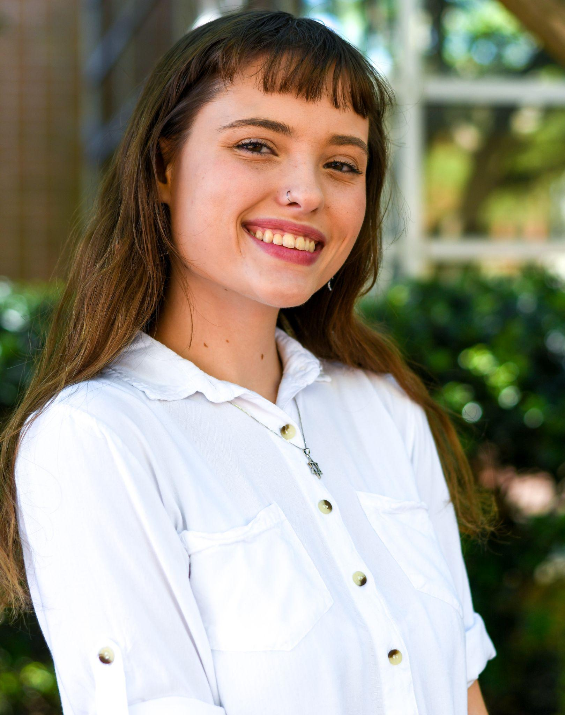
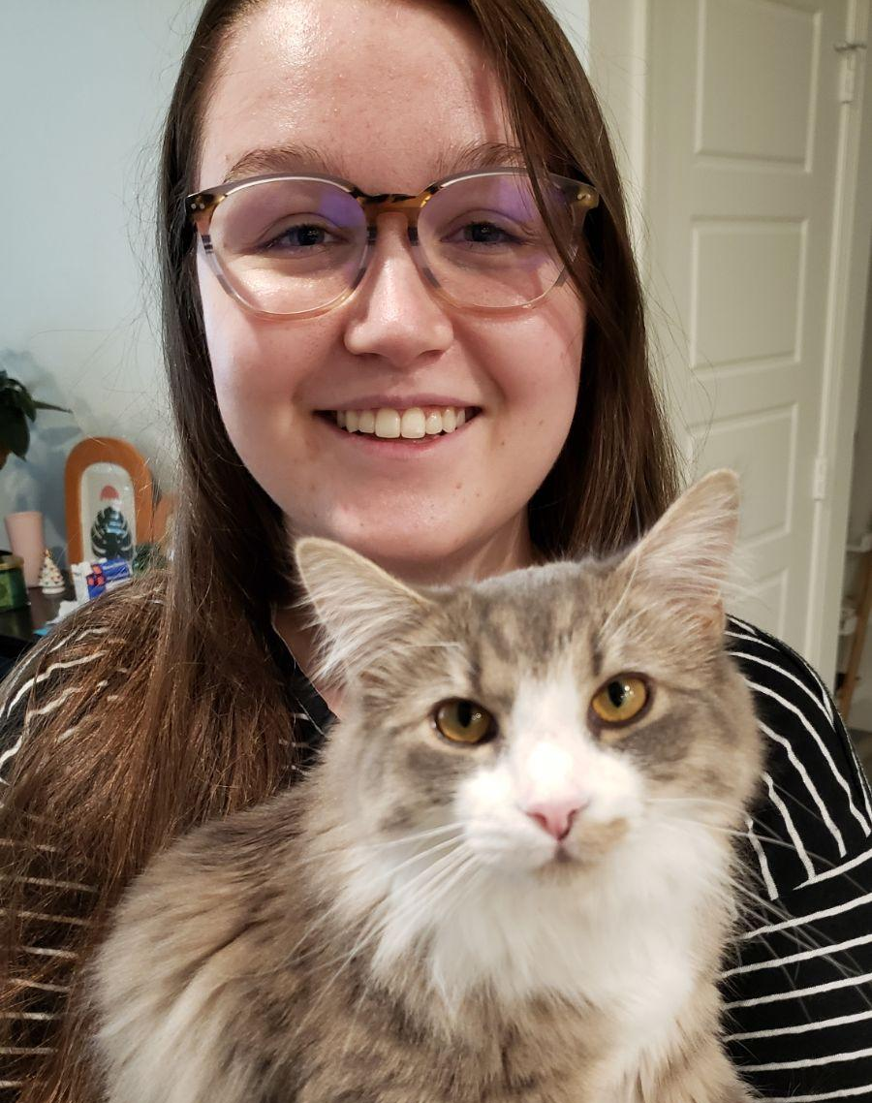
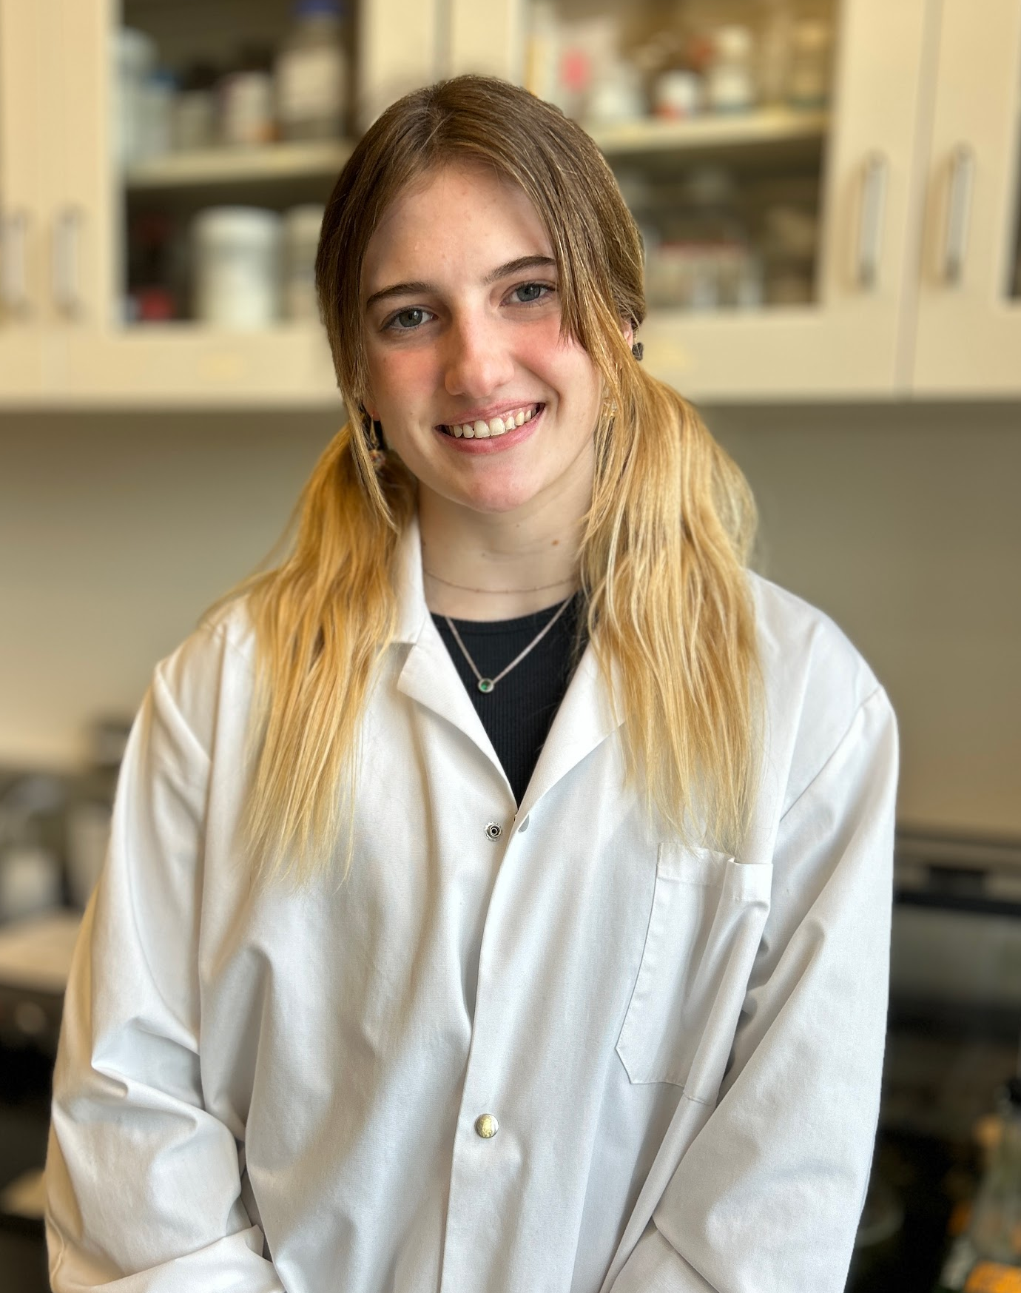
Meet Our Team
Sophie Tanker CTO
Rachel Evans
CEO
Andra Buchan
CFO
Notes:
CEO: Rachel Evans
Rachel Evans is an undergraduate student in Bioinformatics with experience in both management and more than half a dozen different work environments. Her own medical history as well as a deep interest in public health and wellness gives Ansora a unique outlook on the supplement industry.
CTO: Sophie Tanker
Sophie Tanker is an early entry Master’s student in Bioinformatics with experience in both frontend and backend design. Her previous experience with patent preparation and prosecution has allowed Ansora to develop a long-term plan for protection of our intellectual property, ensuring best ROI for our investors.
CFO: Andra Buchan
Andra Buchan is an early entry Master’s student in Bioinformatics and an Olympic level diver with experience in genetic data analysis, handling DNA, advertising, design, and customer outreach. Her experience in an elite athletic environment and partnerships with companies allows Ansora to more effectively reach out to the athletic and active community, one of Ansora’s largest customer groups.

Slide 6
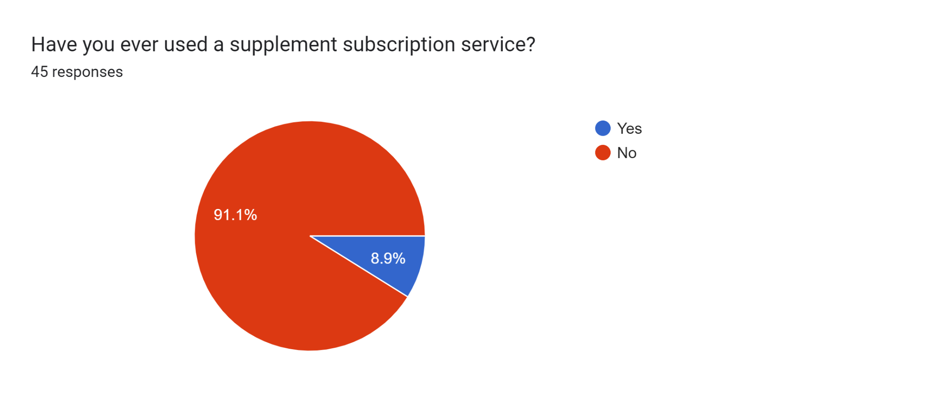
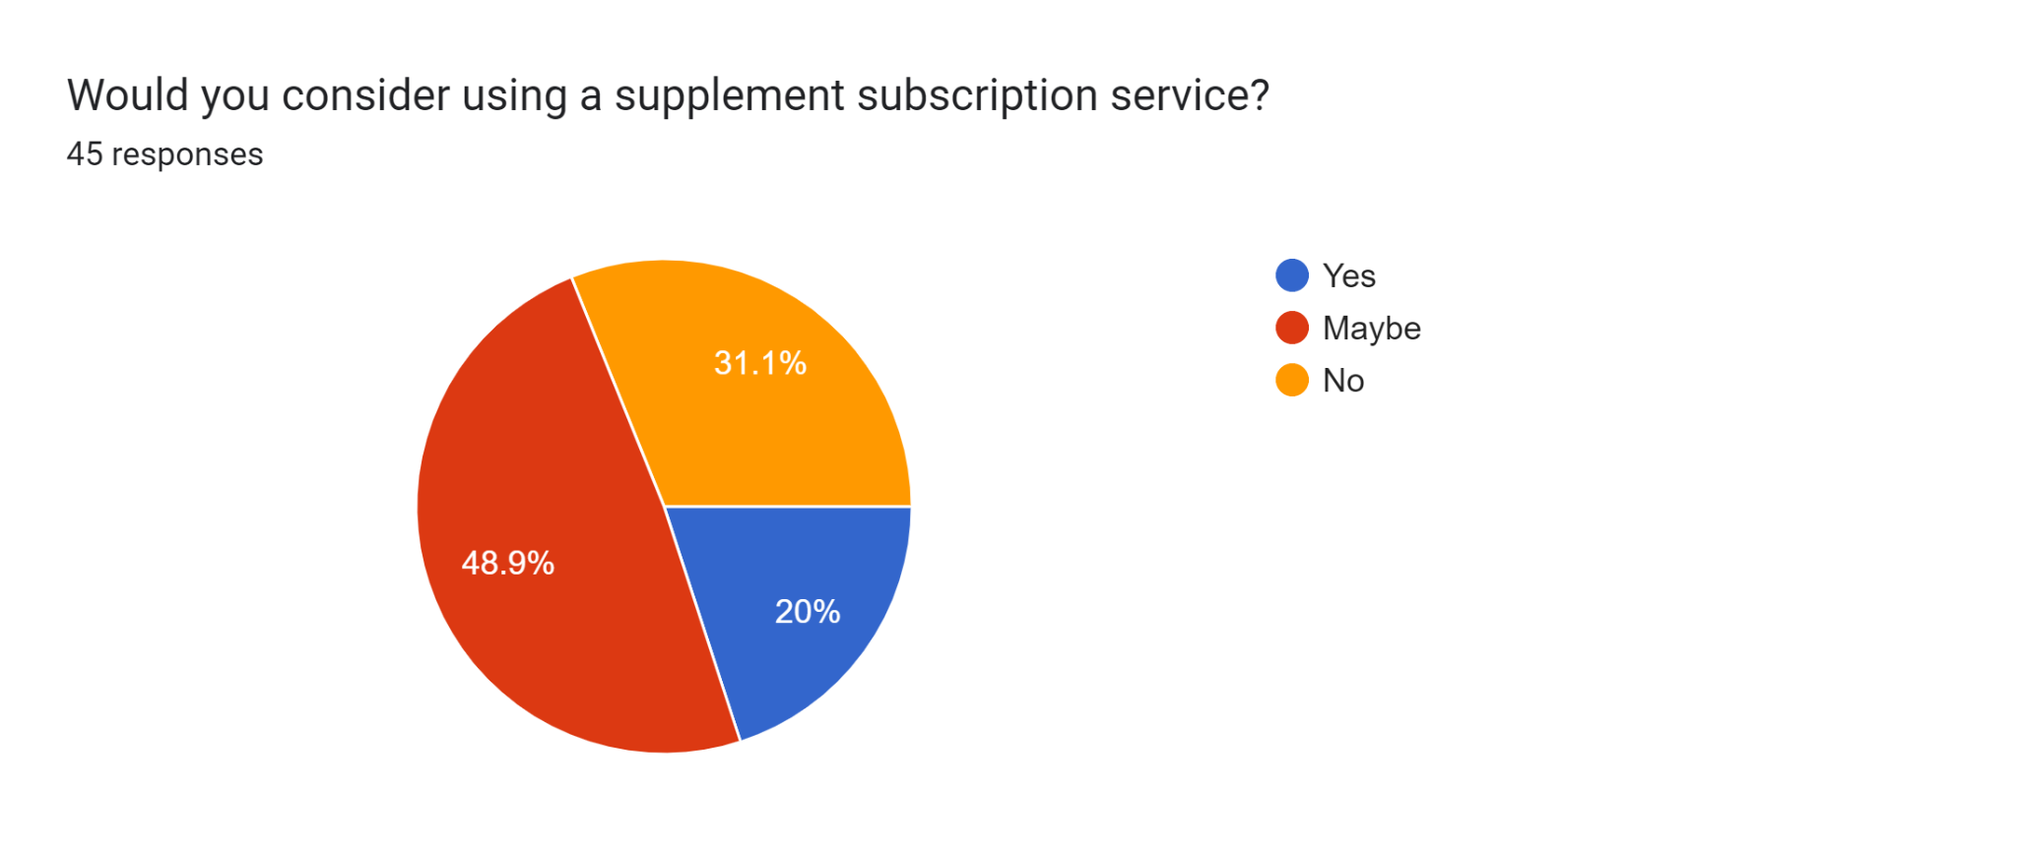
Would people buy this?
Have you ever used a supplement subscription service?
Sample space: 45
Would you consider using a supplement subscription service?
Sample space: 45
Notes:
68.9% said “Yes” or “Maybe” when asked if they would consider using a supplement subscription service.

Slide 7
Customer Discovery Takeaways
Out of 30+ individuals surveyed:
Affordability
Independent lab-verified quality
Transparent information about ingredients origin and efficacy
Strict privacy and security policies
were the most highly valued.

Slide 8
TAM/SAM/SOM
United States Population:
~331.9 million
People in the United States who take supplements
~175.5 million
People in the United States who take supplements and use subscriptions

Slide 9
Pricing
One time fee for Genetic Analysis: $249.99
Monthly payment for Supplements: $49.99
Payment plan for Genetic Analysis: $21/month for a year + $49.99/month for Supplements = $70.99/month

Slide 10

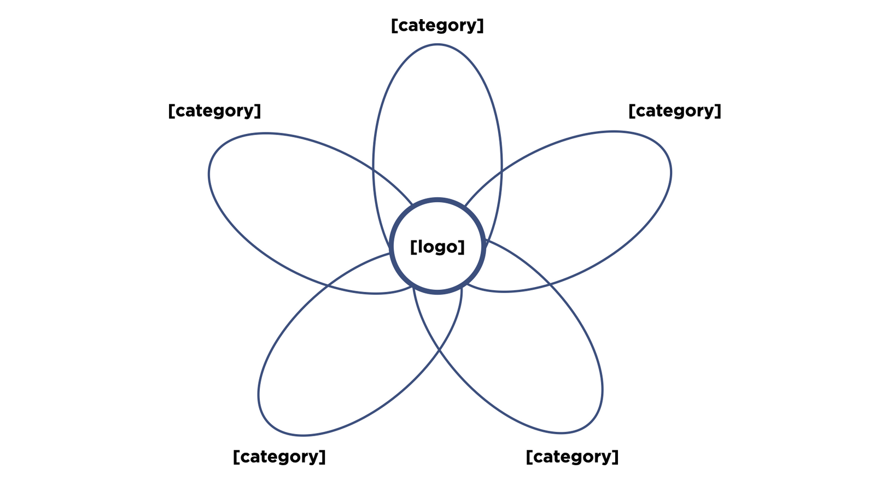












Genetic Health Testing
DNA Sequencing
Custom Supplements
Over-the-Counter Supplements
DNA Sequencing in Healthcare

Slide 11
ansora vs. competitors
Market | Supplements and Genetics | Genetics | Supplements | Supplements
Price | $71/month for the first year, $49/month after | $119 for Ancestry Service | $78/month supply | $95/month supply
Benefits | Scientifically proven nutritional support based on genetic data | Questionable claims about genetic predisposition and ancestry | Claims of personalized treatment; no efficacy studies | Claims of personalized treatment; no efficacy studies

Slide 12
Company Ecosystem
Customer
$
personalized supplements
Microarray data
Lab/personnel
DNA sample
$
$
$
Lab equipment
Supplement/packaging wholesale

Slide 13
Timeline
2024 Order customized microarrays Obtain necessary equipment Create website File provisional utility patent | 2025 Begin trial period Establish NIL partnership program | 2026 Further employee recruitment Gain customer loyalty | 2027 Begin to see profit Assess foreign market and expansion opportunities

Slide 14
Budget: $7 Million
Vitamins | $2M
Data Storage | $2-$4 per GB monthly
Staff/Legal | $2.5M
Advertising | $1M
Customized Microarray | $100K

Slide 15
Thank you!

